Slide 1
CSE 2233 Theory of Computation
Shekh. Md. Saifur Rahman
Lecturer, CSE Department UIU

Slide 2
Course Policy: Counseling
Email me for counseling
Do not call me after office hour.
Bring up specific problems

Slide 3
Reference Books
Introduction to Automata Theory, Languages, and Computation, by John Hopcroft, Rajeev Motwani, and Jeffrey Ullman (3rd edition)
Introduction to the Theory of Computation (2nd ed. 2006). by
Michael Sipser

Slide 4
Why TOC
How to develop thinking in computer
Very Close to AI
Lays the Foundation for a lot of abstract areas of Computer Science (H/W & S/W)
Which problem are solvable?
Computability Theory
Provides the basis for creating correct models of computational tools – both software and hardware
Java Code
Machine Code
Compiler

Slide 5
Theory of Computation (TOC)
Theory of Computation tries to answer the following questions:
What are the mathematical properties of computer hardware and software?
What is a computation and what is an algorithm? Can we give rigorous mathematical definitions to these notations?
What are the limitations of computers? Can everything be computed?
Our main purpose is to determine:
What can and can’t be computed?
How quickly?
With how much memory?
On which type of computational model?

Slide 6
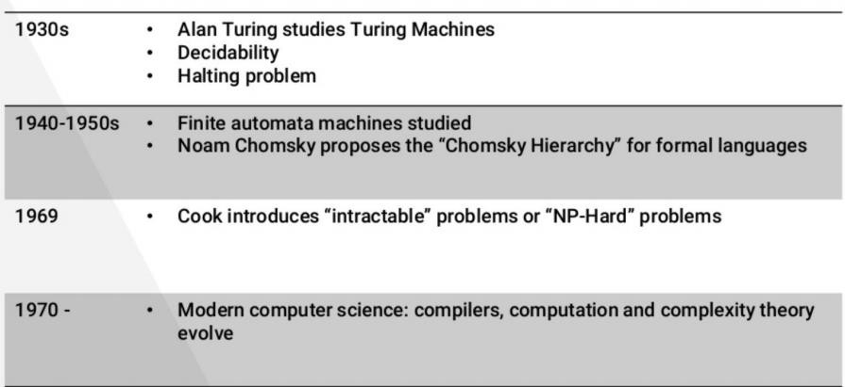
History of TOC

Slide 7
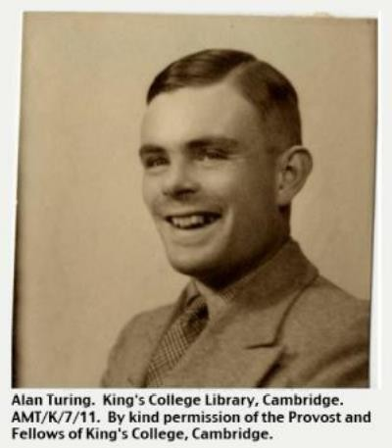
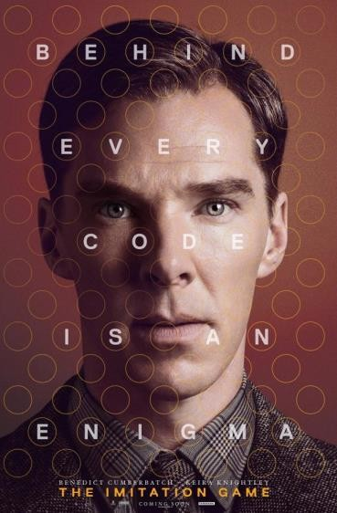
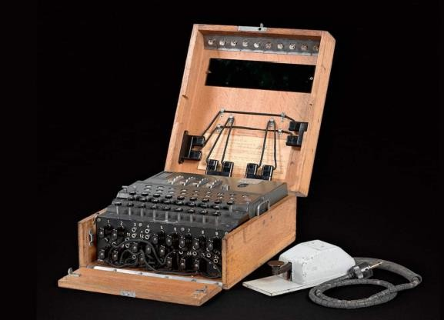
Alan Turing - Facts
Turing (1912-1954) is one of the founders of Computer Science (he was an English Mathematician)
Important facts:
Invented Turing machines
Invented the Turing Test
Broke the German Submarine transmission coding machine “Enigma”
Prosecuted for being Gay
Committed suicide after being prosecuted.

Slide 8
Why this course?
This course is about the fundamental capabilities and limitations of computers. These topics are the core of computer science.
It is about mathematical properties of computer hardware and software.
To design new programming languages, compilers, string searching, pattern matching, computer security, artificial intelligence etc. this course will provide you the basics.
This course helps you to learn problem solving skills. Theory teaches you to think, prove, argue, solve problems, express, and abstract.
This theory simplifies the complex computes to an abstract and simple mathematical model, and helps you to understand them better.
This course is about rigorously analyzing capabilities and limitations of systems.

Slide 9
Central Areas - TOC
Theory of Computation has 3 central areas:
Complexity Theory
Computational Theory
Automata Theory
They are linked y the question:
What are the fundamental capabilities and limitations of computers?
Each of the three areas interpreted this question differently and the answers vary according to the interpretations.

Slide 10
Complexity Theory
Computer problems come in different varieties.
Some are easy, and some are hard.
What makes some problems computationally hard and others easy?
This is the central question of complexity theory.
Remarkably, we don’t know the answer to it, though it has been intensively researched
for over 40 years.
Later, we explore this fascinating question and some of its ramifications.
Motivation of Complexity Theory: Classify problems according to their degree of “computational difficulty” by giving a rigorous proof that certain problems that seem to be “hard” are really hard.
Example of an easy problem: Sorting a set of array elements.
Example of a hard problem: Scheduling courses to satisfy some reasonable constraints.

Slide 11
Computability Theory
Which problems can be solved by computers and which can’t?
In the 1930’s Gödel, Turing, and Church discovered that some of the fundamental
mathematical problems can’t be solved by a “computer”.
Ex - Determining whether a mathematical statement is true or false!!
It seems like a natural for solution by computer but no computer algorithm can perform this task.
The theoretical models that were proposed in order to understand solvable
and unsolvable problems led to the development of real computers.
Motivation of Computability Theory: Classify problems as being solvable or unsolvable.

Slide 12
Automata Theory
Automata Theory deals with the definitions and properties of different types of “mathematical models of computation”.
For example,
Finite Automata – These are used in text processing, compilers, and hardware
design.
Context-Free Grammars – These are used to define programming languages and in Artificial Intelligence.
Turing Machines – These form a simple abstract model of a “real” computer, such as your PC at home.
Motivation of Automata Theory: Determine the power of different computational models or, which model can solve more problems than the other.

Slide 13
Thank you

